Slide 1
Getting Started With PHP
Prerequisites: sql, html/html5, css, db handling

Slide 2
Content Layout
What is PHP and why use PHP?
What do I need?
Your first PHP-enabled page
HTML before PHP
Creating database connection
Fetching data (select query)
HTML after PHP
Adding data (insert query)
Updating data (update query)
Delete data (delete query)
Closing database connection
Tips and hints

Slide 3
WHAT IS PHP AND WHY USE PHP?
PHP stands for recursive acronym: Hypertext Processor.
PHP is a server-side scripting language.
PHP is open source and free.
PHP is cross platform; this means you can deploy your application on several different operating systems such as windows, Linux, Mac OS etc.
PHP code may be embedded into HTML code, or it can be used in combination with various web template systems, web content management system and web frameworks.
The PHP code is enclosed in special start and end processing instructions <?php and ?> that allow you to jump into and out of "PHP mode."

Slide 4
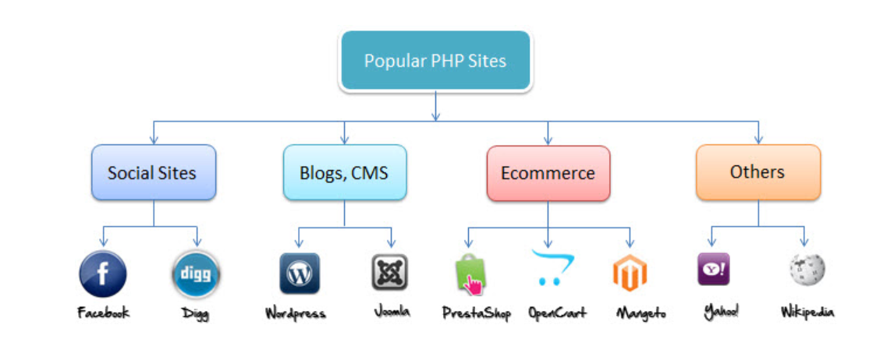

Slide 5
WHAT DO I NEED?
XAMPP
Web Server (Apache)
Database (MySQL)
PHPMYADMIN
Create database – create/insert .SQL scripts.
ATOM
Create .PHP scripts
Run these scripts on your database locally

Slide 6
YOUR FIRST PHP – ENABLED PAGE
PHP code is written between <?php …. ?>
Can jump in and out of html whenever required.
PHP files are generally saved using .php extension.
To run php script locally, save your script under server’s root directory and then enter script path in your browser.
In case of using XAMPP, save your .php file here: XAMPP > Htdocs > db_name > script.php Example: XAMPP > Htdocs > Sample > Hello.php
To run script in your web browser: http://localhost/db_name/script.php Example: http://localhost/sample/hello.php
<html>
<head>
<title> hello world </title>
</head>
<body>
<?php
echo 'hello world';
?>
</body>
</html>

Slide 7

HTML BEFORE PHP
<html>
<head>
<title> select</title>
</head>
<body>
<form method="post" action="query1.controller.php">
<fieldset>
<legend> Query 1 </legend>
<label id="label" for=“name"> Student Name </label> </br>
<input type="text" name="name" placeholder=" Enter student name" > </br>
<input id="button" type="submit" name="submit">
</fieldset>
</body>
</html>
How will you insert, update, select, or delete without taking user input?
You will have to create a simple HTML form to take user input which you will later validate and execute in your php scripts.
You can go with MVC method (model view controller) in which you create two separate files for each query – first, HTML page to take user input and second, PHP script where you create connection and execute sql query.
Notes:
‘Get’ and ‘Post’ are two different HTTP request methods. Get is used to view something without changing it, while POST is used for changing something.
For example, a search page should use GET to get data while a form that changes your password should use POST.
Essentially GET is used to retrieve remote data, and POST is used to insert/update remote data.
When the user fills out the form above and clicks the submit button, the form data is sent for processing to a PHP file named "query1.controller.php". The form data is sent with the HTTP POST method.
PHP MVC Frameworks simplify working with complex technologies by hiding all complex implementation details such as connecting to the database, sanitizing user input etc. are already partially implemented.

Slide 8
CREATING DATABASE CONNECTION
Using PDO (PHP Data Objects)
Syntax:
Using MySQLi ( ‘i’ stands for improved)
Syntax:
$conn = new mysqli ($host, $dbusername, $dbpassword, $dbname);
// Check connection
if (mysqli_connect_error()){
die('Connect Error ('. mysqli_connect_errno() .') '
. mysqli_connect_error());
}
$conn = new PDO ('mysql:host='.$host.’; dbname='.$dbname, $dbusername, $dbpassword);
// Check connection
if(!$conn) {
die("Connection failed");
}
Use of PDO (PHP Data Objects) is generally encouraged over mysqli (mysql Improved) since it can be used with 12 different types of databases and it has simpler syntax.
You may use any method of your choice.
Notes:
To switch your project to use another database, PDO makes the process easy, because PDO is compatible with 12 different types of databases.
To learn more check this link >> https://websitebeaver.com/php-pdo-vs-mysqli

Slide 9
CREATING DATABASE CONNECTION (CONT.)
<?php
$host = "localhost";
$dbusername = "root";
$dbpassword = “ ";
$dbname = “db_name";
// Create connection
$conn = new PDO('mysql:host='.$host.';dbname='.$dbname, $dbusername, $dbpassword);
// Check connection
if(!$conn) {
die("Connection failed");
}
else { ---- ---- }
?>
Declaring the database. Generally the hostname, username and password remains the same in case running it locally.
Creating / establishing the connection. Here, ‘$db’ is a variable name which is used for creating new database connection by calling database identifiers from above as parameters here.
Checking for successful connection. In case any error occurred (no database found, wrong username, etc.) it will end connecting and throw ‘connection failed’ error message.
Else it will create connection with database and start processing the code in ‘else’ scope.
Important: your main code should be put inside ‘else’.

Slide 10
FETCHING DATA (SELECT QUERY)
else{
$name = filter_input(INPUT_POST, 'name’);
if ($query = "SELECT studentid, name, dept, gpa FROM students WHERE Name = :name")
{
if($query==null){
echo "No Record Available";
die();
}
else{
$stmt = $conn>prepare($query);
$stmt->execute(array(':name' => $name));
$rows = $stmt->fetchALL(PDO::FETCH_ASSOC);
}
}
}
Validating the input from HTML Form, and storing it in php variable - $name
Defining a variable, $query, which will be used to execute SQL query. Putting this variable in ‘if’ clause for validation.
If there is no data set which matches with the query, it will print ‘No Record Available’
Else $stmt variable will ‘prepare’ $query and will send it to database connection ‘$conn’.
It will execute ‘where’ clause.
Then ‘fetchall’ matching records in variable $rows.
Notes:
filter_input: Gets a specific external variable by name and optionally filters it.
INPUT_POST: is the input type. Other types are INPUT_GET, INPUT_COOKIE, INPUT_SERVER, or INPUT_ENV.
Prepare: An SQL statement template is created and sent to the database. The database parses, compiles, and performs query optimization on the SQL statement template, and stores the result without executing it.
Execute: The application binds the values to the parameters, and the database executes the statement. The application may execute the statement as many times as it wants with different values.
PDOStatement::fetchAll — Returns an array containing all of the result set rows

Slide 11
HTML AFTER PHP
<html lang = "en">
<head>
</head>
<body>
<?php
foreach ($rows as $row) {
echo $row["studentid"]; echo '</br>';
echo $row["name"];
echo $row["dept"];
echo $row["gpa"];
}
?>
</body>
</html>
How will you show the result executed by the query?
You can use simple HTML code where you will call php variable (here, $rows) which have stored the results of executed sql query in php script.
Again, you can use any method you wish. Either you can embed HTML output code in php script, or you can create a different html file to call php output variable.
Notes:
The foreach loop is mainly used for looping through the values of an array. It loops over the array, and each value for the current array element is assigned to $value, and the array pointer is advanced by one to go the next element in the array.

Slide 12
ADDING DATA (INSERT QUERY)
else{
$studentid = filter_input(INPUT_POST, 'studentid');
$name = filter_input(INPUT_POST, 'name');
$dept = filter_input(INPUT_POST, 'dept');
$gpa = filter_input(INPUT_POST, 'gpa’);
$query = "INSERT INTO students (studentid, name, dept, gpa)
values ('$studentid','$name', '$dept', '$gpa')";
if ($conn->query($query)){
echo "New record is inserted sucessfully";
}
else{
echo "Error: ". $query ."
". $conn->error;
}
Validating inputs from HTML form and storing in php variables
Writing Insert sql query in $query
If query is correct and matches the database structure, record is inserted.
Else it will throw error.

Slide 13
UPDATING DATA (UPDATE QUERY)
else{
$studentid = filter_input(INPUT_POST, 'studentid');
$gpa = filter_input(INPUT_POST, 'gpa');
$query = "UPDATE students SET gpa = '$gpa’ WHERE studentid = '$studentid'";
if ($conn->query($query)){
echo "Record updated sucessfully";
}
else{
echo "Error: ". $query ."
". $conn->error;
}
Validating inputs from HTML form and storing in php variables
Writing Update sql query in $query
If query is correct and matches the database structure, record is updated.
Else it will throw error.

Slide 14
DELETE DATA (DELETE QUERY)
else{
$studentid = filter_input(INPUT_POST, 'studentid');
$query = "DELETE FROM students WHERE studentid = '$studentid'";
if ($conn->query($query)){
echo "Deleted successfully";
}
else{
echo "Error: ". $del ."
". $conn->error;
}
Validating inputs from HTML form and storing in php variables
Writing Delete sql query in $query
If query is correct and matches the database structure, record is deleted.
Else it will throw error.

Slide 15
CLOSING DATABASE CONNECTION
“ $conn->close(); “ is used to close the database connection. Here, ‘$conn’ is the variable name we used to establish the database connection earlier.
From Slide 9:
$conn = new PDO('mysql:host='.$host.';dbname='.$dbname, $dbusername, $dbpassword);
// Check connection
if(!$conn) {
die("Connection failed");
}
Notes:
For the purpose of safe coding, you should always close database connections explicitly to make sure that the code was able to close itself gracefully and to prevent any other objects from reusing the same connection after you are done with it.
It is always good practice to tie up any loose ends. Here we will learn how to do both.

Slide 16
TIPS AND HINTS
PHP Variables should always start with ‘$’.
It is better to use two different files – html code and database manipulations – for php controllers.
You can start <?php…?> anywhere in the HTML page.
To make calls to your database anywhere in the HTML code, make sure you have established database connection in that .php file.
Echo can help display search query results (embedded in html code) by making calls to input variables (eg: echo ‘$name’). Also, displaying search query results in a tabular form helps organizing results.
Two or more tables can be joined in SQL queries using two different query names. Example: if ($conn->query($query)and ($conn->query($query2))

